Slide 1
Smart sensing network to assist Energy monitoring system for an Industrial Refrigeration facility

Slide 2
Main Concept
The project aims to provide on-site real-time measurements of various parameters like temperature, occupancy, total time of occupancy etc. in zones within an Industrial Refrigeration facility.
These real-time data is later sent to a cloud-based system that investigates the energy performance or energy eﬃciency of Industrial Refrigeration System (IRS).
These parameters could be utilized for the calculation of various refrigeration loads as well as the total essential energy (this is the minimum energy required by a facility).
This total essential energy is later compared with the actual(billed) refrigeration energy to ﬁnd the Benchmark Energy Factor (BEF), which is a measure of the total energy wastage in the system.
The data is measured with a network of sensors connected to microcontrollers and is controlled via a central hub through Bluetooth low-energy communications.
Data is also sent to the AWS (Amazon Web Services) S3 platform for further storage.

Slide 3
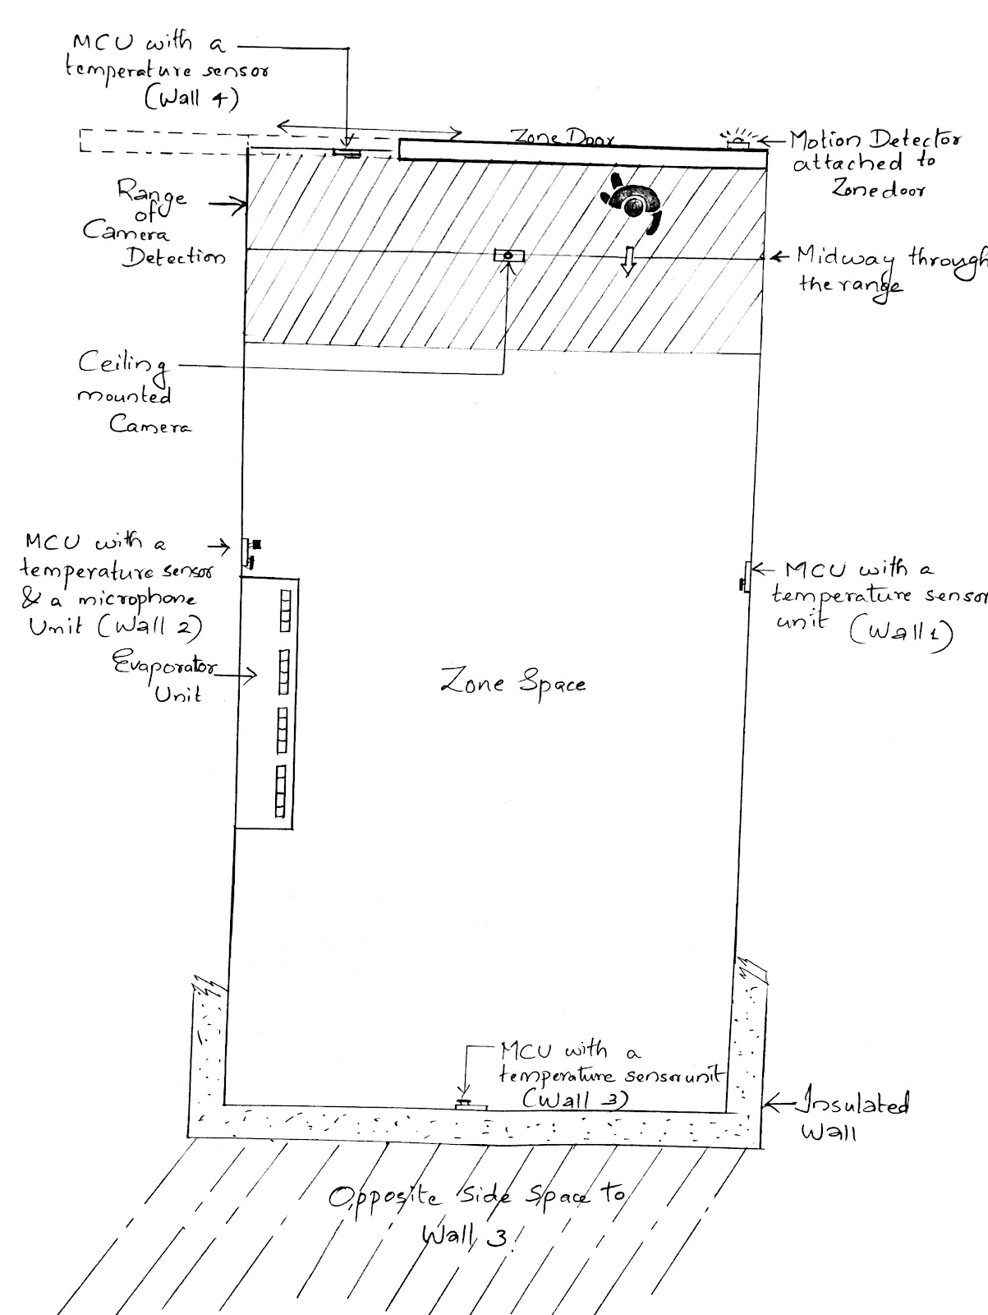
Main Concept

Slide 4
Main Units of the Project
Three main Units:
Raspberry Pi (Central Hub)
Teensy connected to door sensor and relay to control lighting (communicating to Raspberry pi via BLE).
Teensy connected with temperature sensor (communicating to Raspberry Pi via BLE).

Slide 5
Working
Part 1 – Software : Bluez, Gattlib library for BLE, Arduino Bluefruit library
Temperature sensor – sends temperature data every few milliseconds to teensy(i2c).
Teensy receive temperature values and send it to Raspberry Pi via BLE.
Part 2 – Software : Bluez, Gattlib library for BLE, Arduino Bluefruit library
Door Sensor- Teensy- Relay- Lighting.
BLE
Raspberry Pi

Slide 6
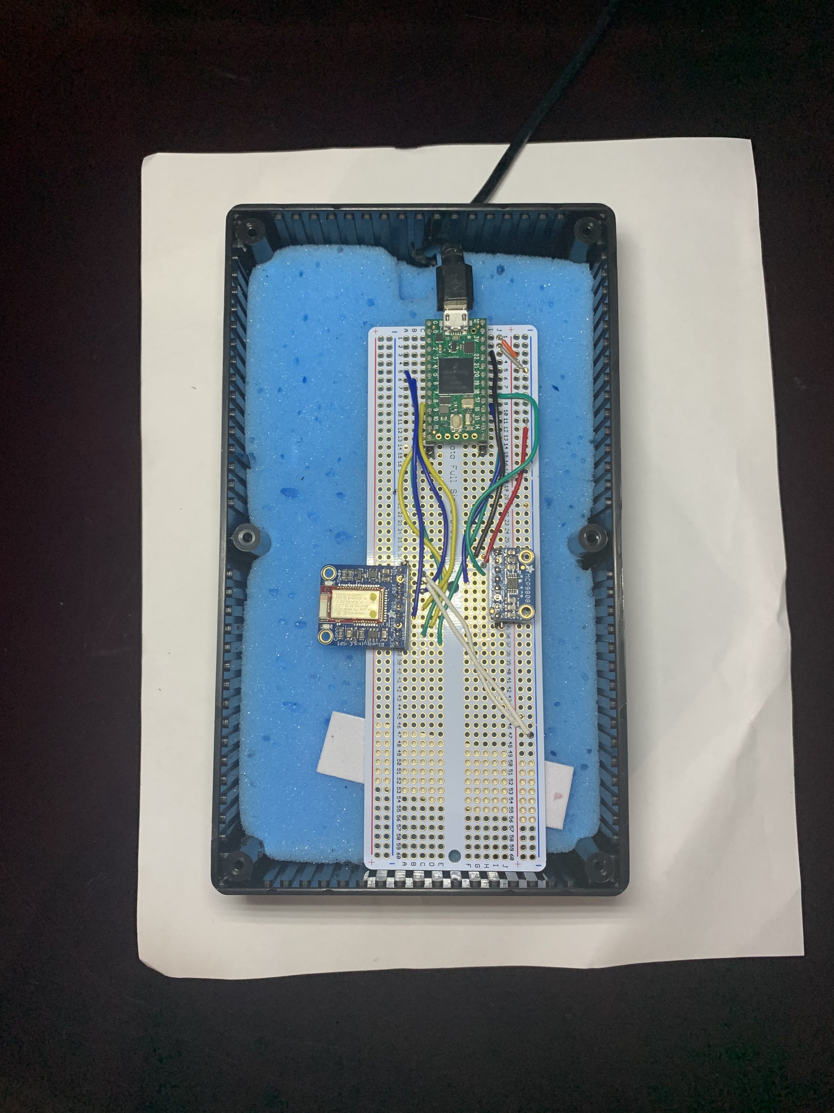
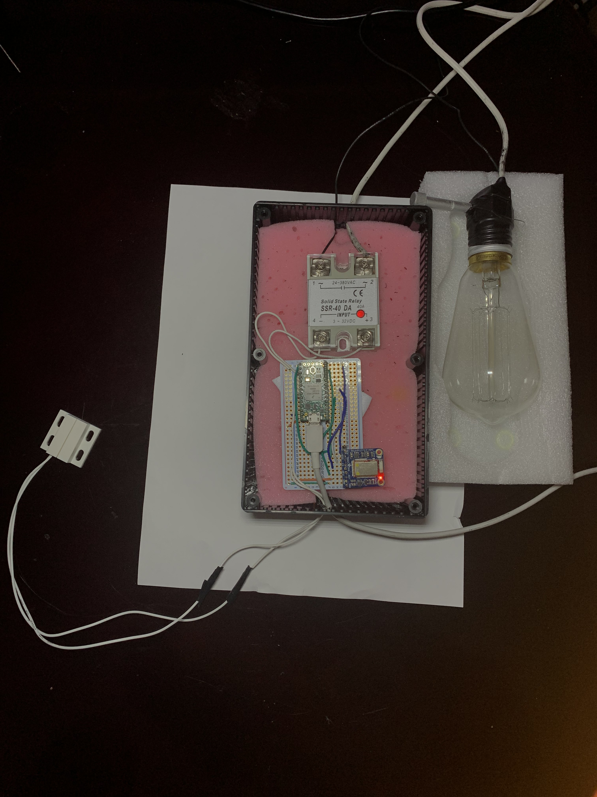
Teensy Setup

Slide 7
Working
Part 3 – Software : OpenCV
Capturing live images and counting number of people inside the zone at any given time
Tracking time for which the zone is occupied
Part 4 – Software : Qt, AWS SDK for S3
Uploading the real-time measurements to AWS Cloud and Github every few minutes.
Displaying the measured data

Slide 8
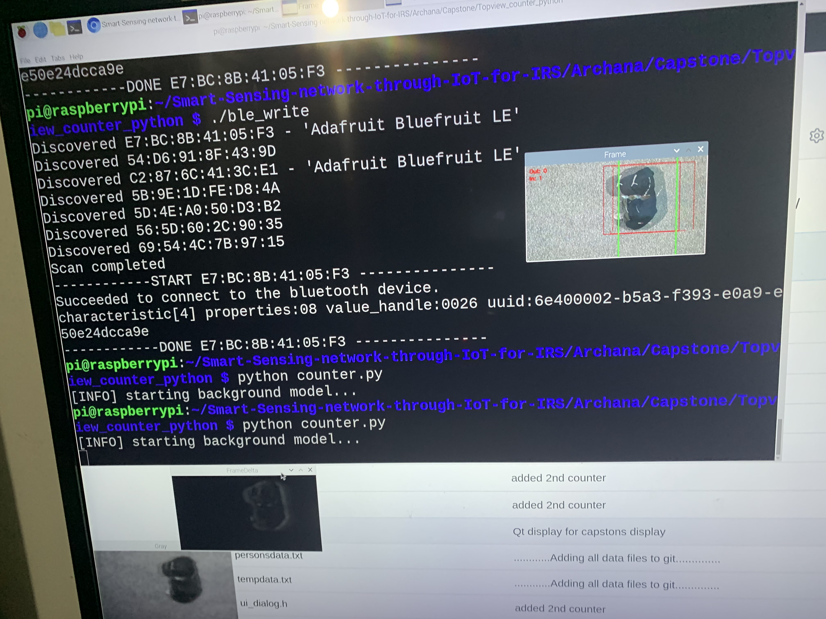
Raspberry Pi detecting the number of people inside the zone

Slide 9
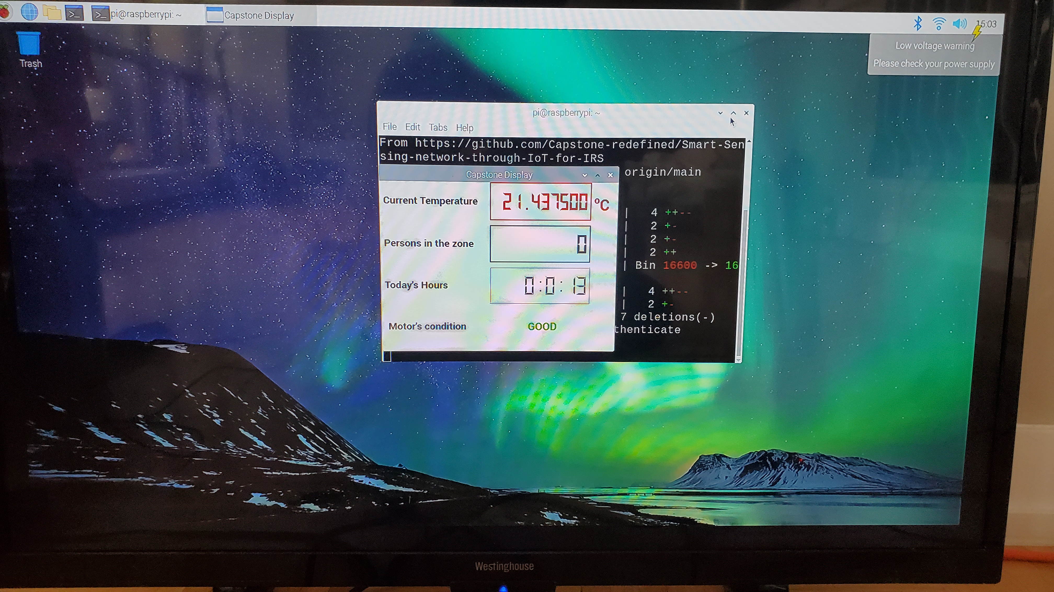
Real-time GUI Display

Slide 10
Challenges faced during the project……
Initially, there was this plan to record the audio data from evaporators within the zone using a microphone, so that the data could later be analyzed to detect any faulty evaporator motor conditions. Unfortunately, we weren’t able to transmit raw audio data through BLE to the central hub successfully as it missed several data packets while transmission.
It was really difficult to find a reliable C/C++ library to work with the BlueZ package on the Raspberry Pi for BLE communication. There was neither enough resources nor documentation on this. But, it was resolved successfully after several attempts.

Slide 11
Short video…….
https://www.youtube.com/watch?v=X3Mn9leFYzM
https://www.youtube.com/watch?v=l3yf8G_RZio
Documentation and Source code
https://github.com/Capstone-redefined/Smart-Sensing-network-through-IoT-for-IRS/tree/main/Archana

